Slide 1
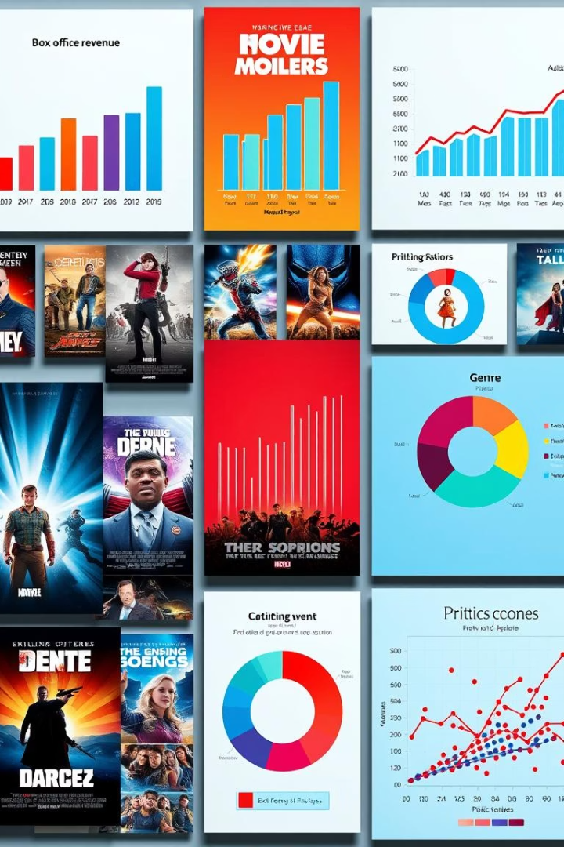

Movie Dataset Analysis Overview
This presentation explores a movie dataset with 25,551 entries and 6 key columns.
We cleaned, categorized, and visualized data to uncover insights on genres, popularity, and trends.
by Prashant Gupta

Slide 2

Dataset Cleaning & Structure
No Missing or Duplicate Data
Columns Dropped
Overview, Original Language, and Poster URL removed for analysis.
9827 original rows, no NaNs or duplicates found.
Date Conversion
Release_Date converted to year format for easier analysis.

Slide 3
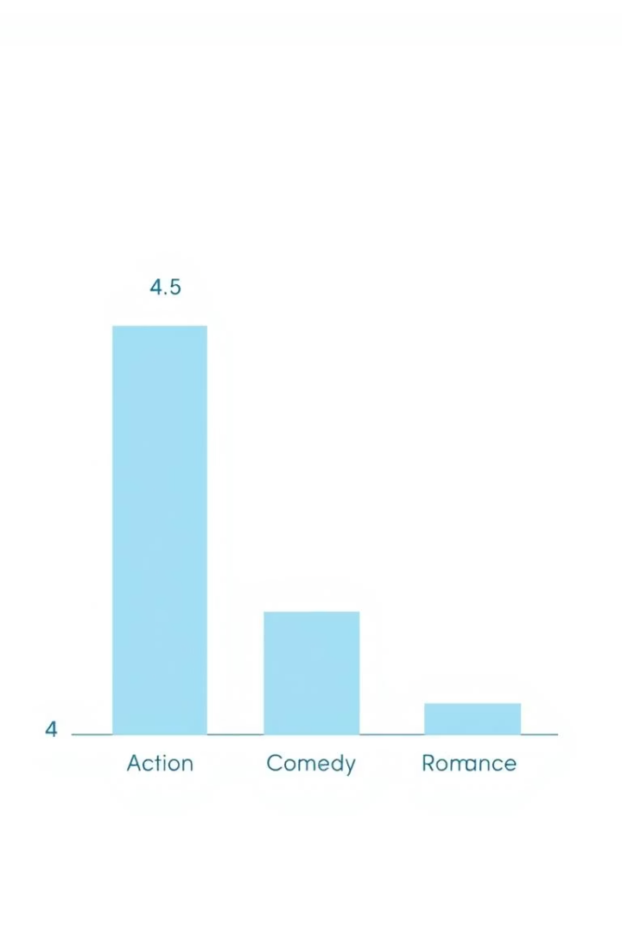
Vote Average Categorization
Four Categories
Balanced Distribution
Votes split into not_popular, below_avg, average, and popular.
Each category contains roughly 2,400 to 2,500 entries.
NaNs Removed
All missing values dropped to ensure clean analysis.

Slide 4
Genre Data Preparation
Genre Splitting
Data Explosion
Category Casting
Genres split from comma-separated strings into lists.
Each genre exploded into its own row for detailed analysis.
Genre column converted to categorical data type.

Slide 5

Genre Frequency Insights
Drama is the most frequent genre, appearing over 14% of the time.
Dataset contains 19 unique genres with Drama leading in count.

Slide 6
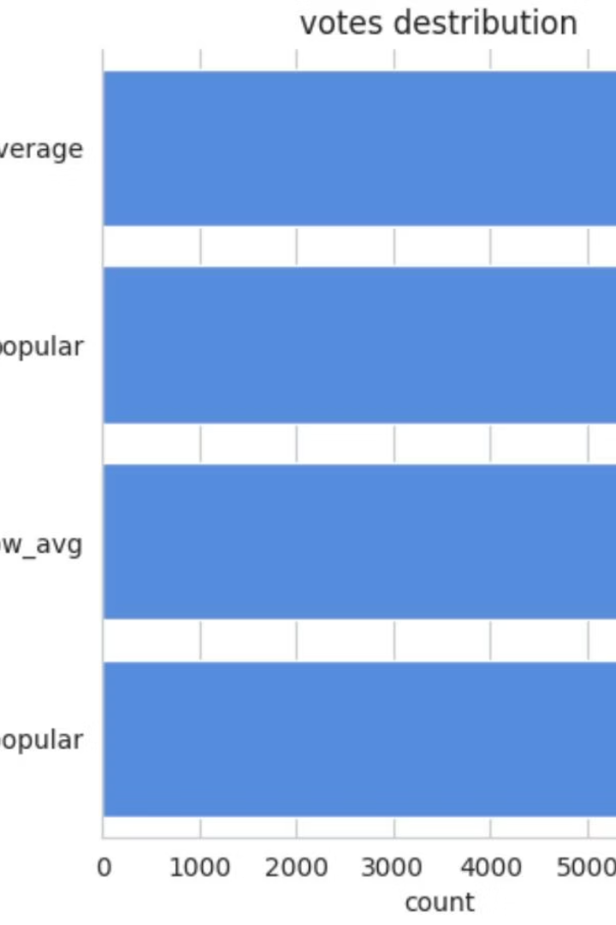
Popularity and Vote Distribution
Vote averages are well distributed across four categories.
Popularity varies widely, with notable outliers like Spider-Man.

Slide 7
Movie Popularity Extremes
Most Popular Movie
Least Popular Movie
Spider-Man: No Way Home tops popularity with 5083.954 score.
The United States vs. Billie Holiday has lowest popularity at 13.354.

Slide 8
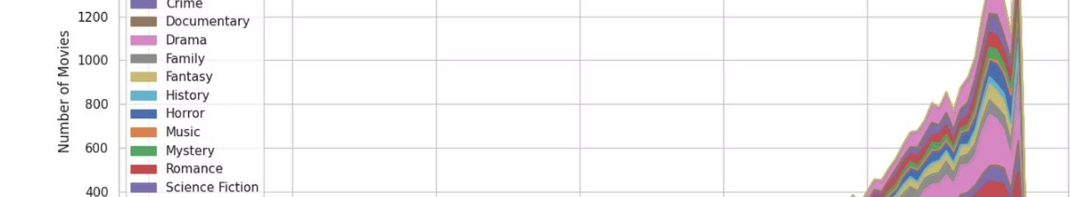
Release Year & Genre Trends
Movie releases peak around recent years with Drama dominant.
Genre trends show shifts in popularity over time across 19 genres.

